Slide 1
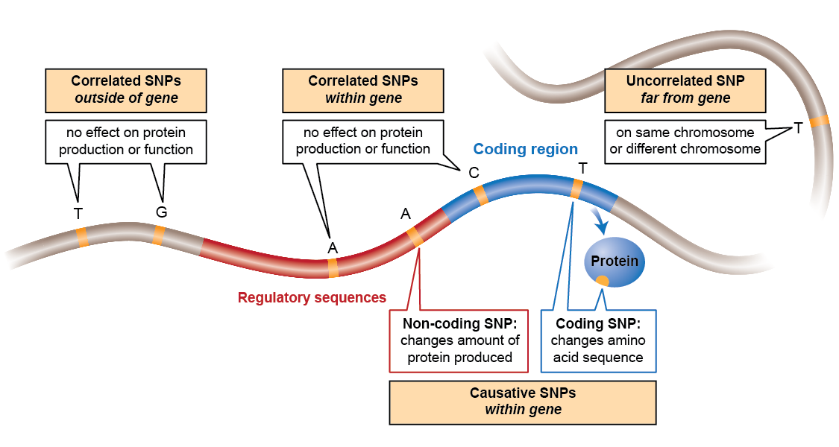
Notes:
SNPs serve as markers for the locations of genes. SNPs can be associated with a trait because they occur within or close to the gene that causes that trait. The locations of the SNPs in the genome serve as markers or signposts for the locations of a gene correlated with a particular trait. (Graphic adapted from Learn Genetics “Making SNPs Make Sense.”)

